Slide 1

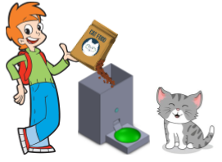
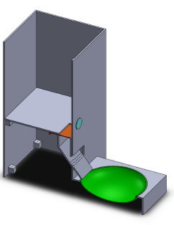

Automatic Feeding Machine Ido Elmaleh, Avichay Nega, Matan Tzabari Yossi Zaguri
Contribution/project goals:
Our product will help many individuals and companies that wish to make the feeding process automatic. By giving their pet an authentication key (RF chip), the machine will fill the food plate upon sensor read. Furthermore, using a database and AI, our product will analyze the pet’s eating behavior to perfect the feeding process without human involvement.
An Automatic Feeding Machine that demands an authentication key for food access.
Introduction:
The AFM (Automatic Feeding Machine) consists of:
ESP32 Chip Microcontroller
RC522 RFID Module
Linear Actuator
Artificial Intelligence
Alternatives: Manual feeding
Design Considerations: Plastic box with power requirements
Methods/algorithms/Alternatives or Design Considerations:
Using Arduino code is uploaded to the controller, and with Node-Red, the AFM can be used from anywhere and communicate via Wi-Fi.
Feeding behavior is analyzed with Artificial Intelligence and based on the interaction of the pet with the AFM.
Selected Approach:
Once the container is filled with food, and a pet with an authentication key has gotten
closer to the sensor, a linear actuator will open the gate and the plate will be filled.
After several uses, the AI will change the amount and the duration of the actuator based on the eating habits of the animal.
Solution Description (Algorithms, Modulation, Patterns, Infrastructure, UI, Functionality)
Visit Us

